Slide 1

WHAT MATTERS MOST TO REDUCE CO2 EMISSION IMPACT OF MY VEHICLE?
Team 1 – Project 3

Slide 2

Team members
Algernon Jordan
Carolina Fuentes
Ebeni Bermudez
Notes:
eb

Slide 3
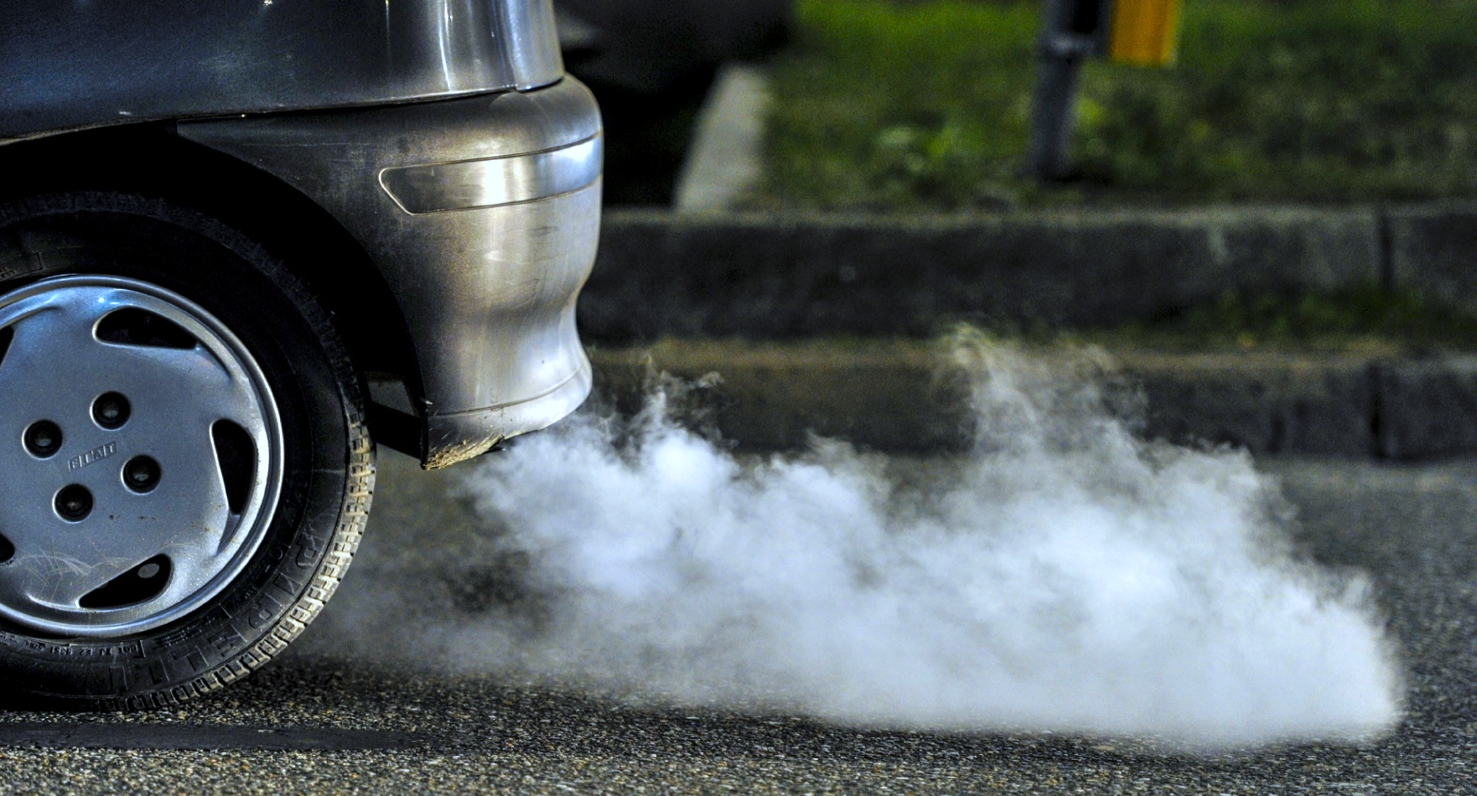
Our problem statements
What variables give me the
“best bang for my euro”
to lower Co2 impact?
An exploration of how European consumers can influence CO2 emissions in 2021.

Slide 4

































There are hundreds of car makers around the world, ranging from large multinational corporations to smaller, regional manufacturers. Our focus is on these brands

Slide 5
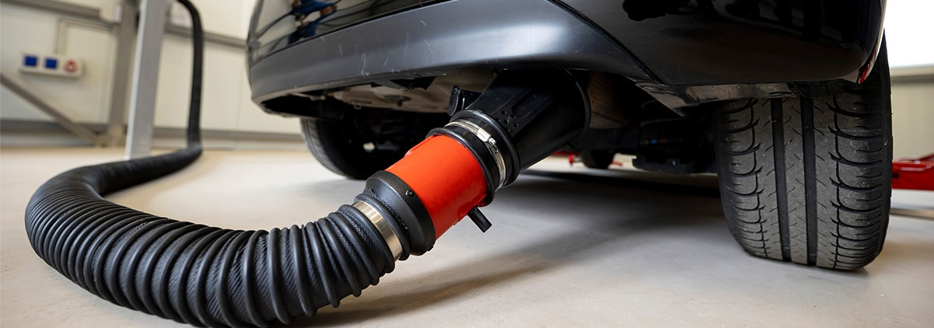
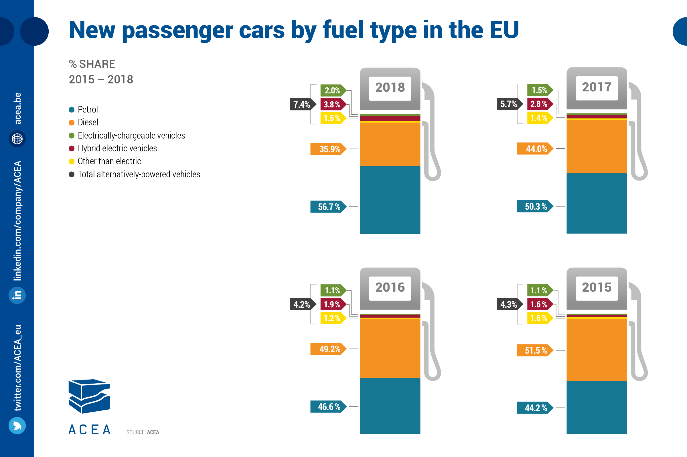
There are
different
fuel types
in the 27 European Union countries
we focused
on petrol

Slide 6
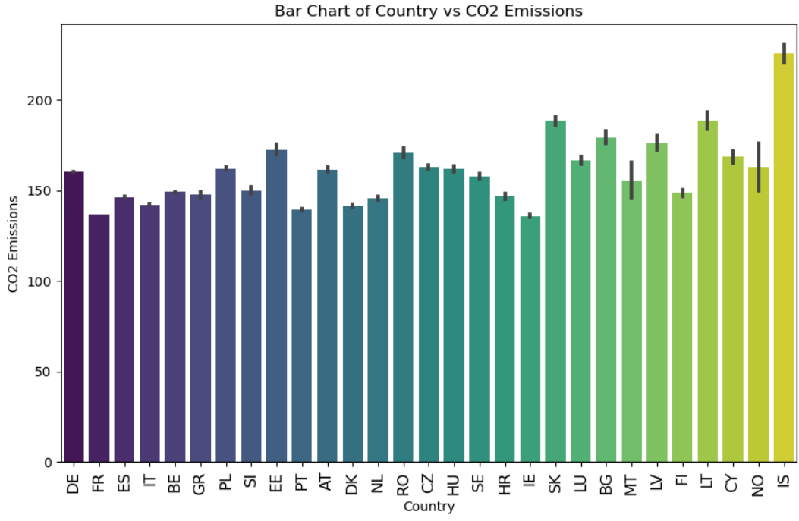

think of European countries with most & least co2 emissions, who comes to mind?

Slide 7
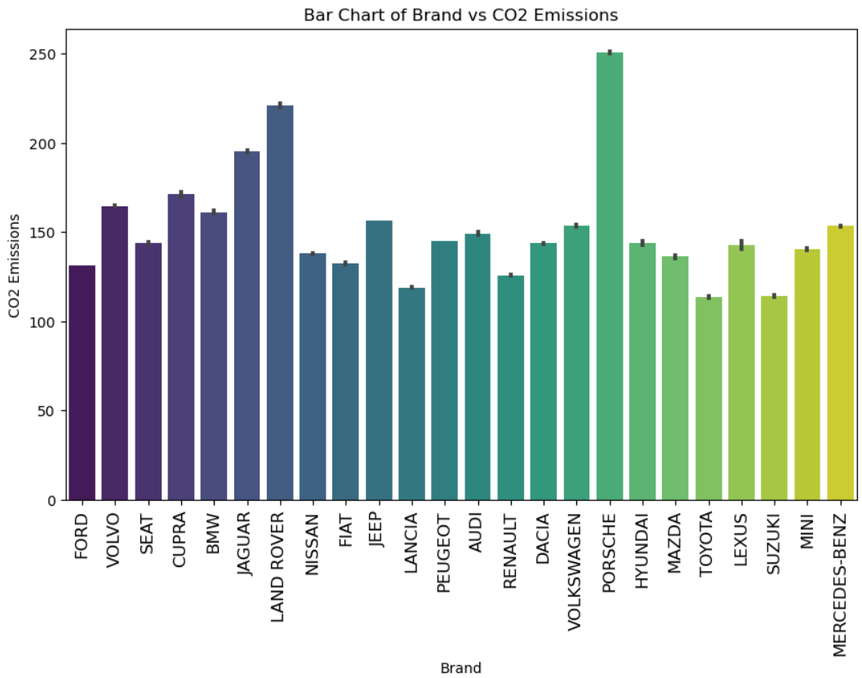
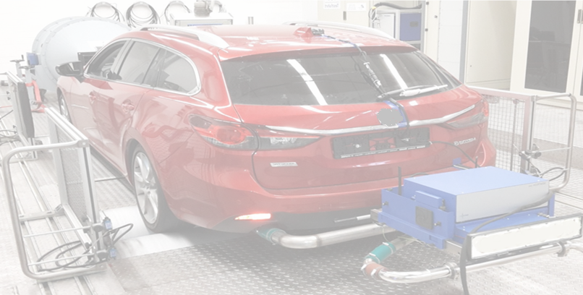
think of European vehicles with most & least emissions, who comes to mind?

Slide 8
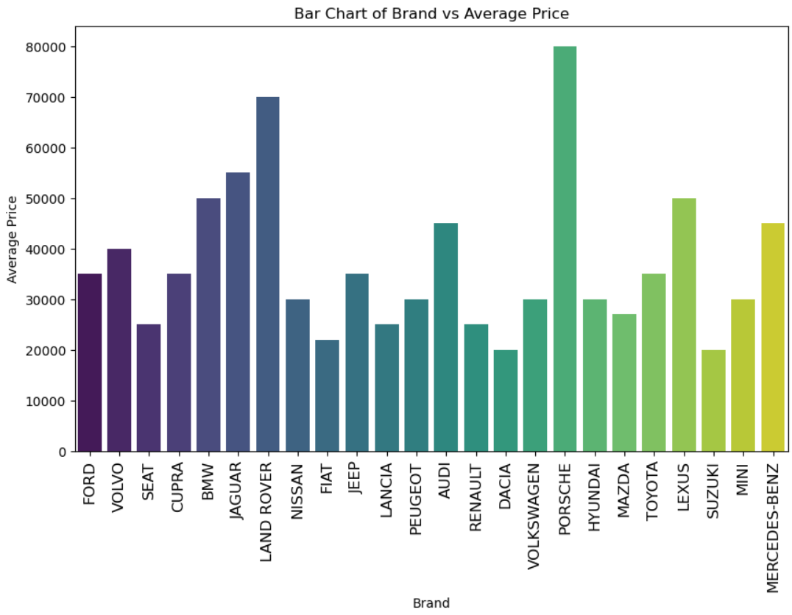
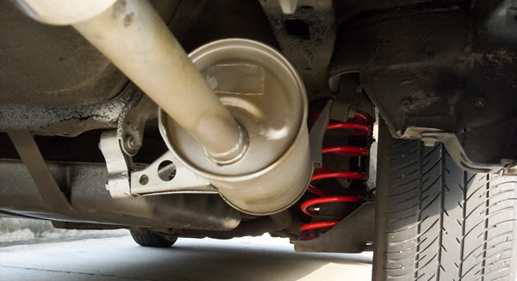
think of most & Least expensive European vehicles, what comes to mind?

Slide 9

What really matters when it comes to reducing emissions?

Slide 10
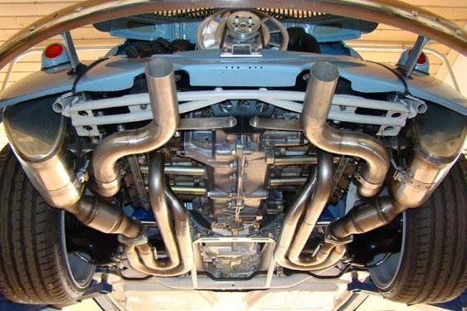
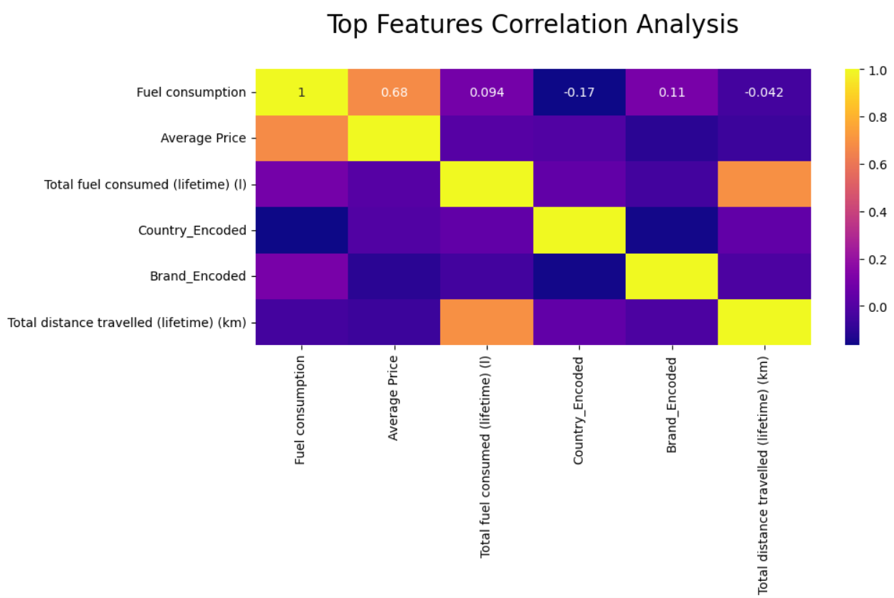

Slide 11

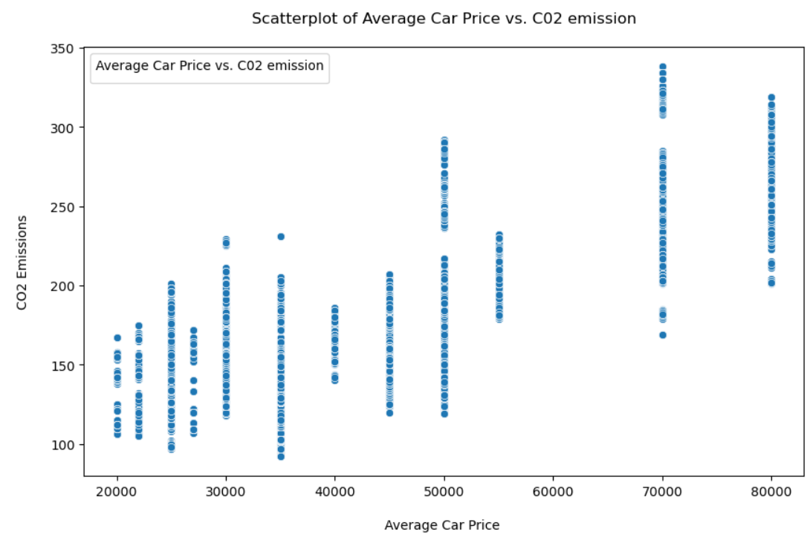
If price matters, should I go to a higher price point?

Slide 12
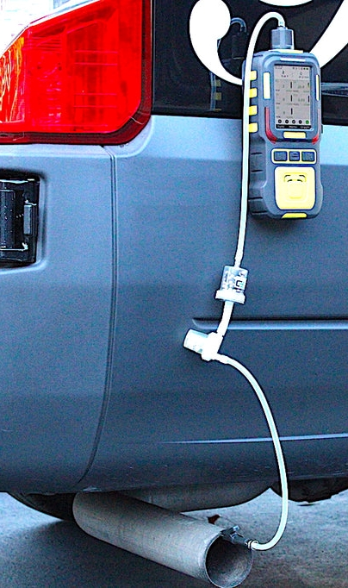
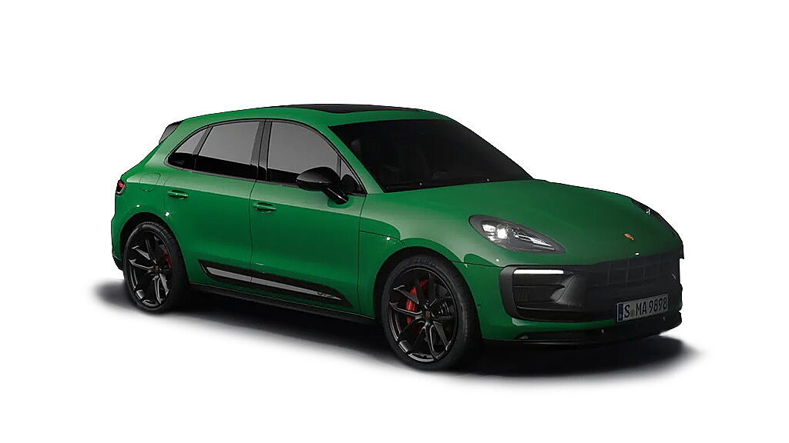
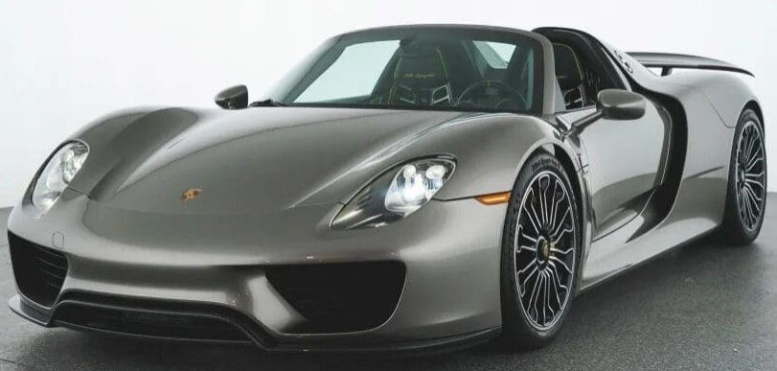
Remember Porsche?
Porsche Macan
Starting Price: Approx €55,000 & 10.2 KPL
Porsche 918 Spyder
Starting Price: Approx
€1,000,000 & 9.4 KPL
There is huge variation in cost within each car brand. we used average price

Slide 13
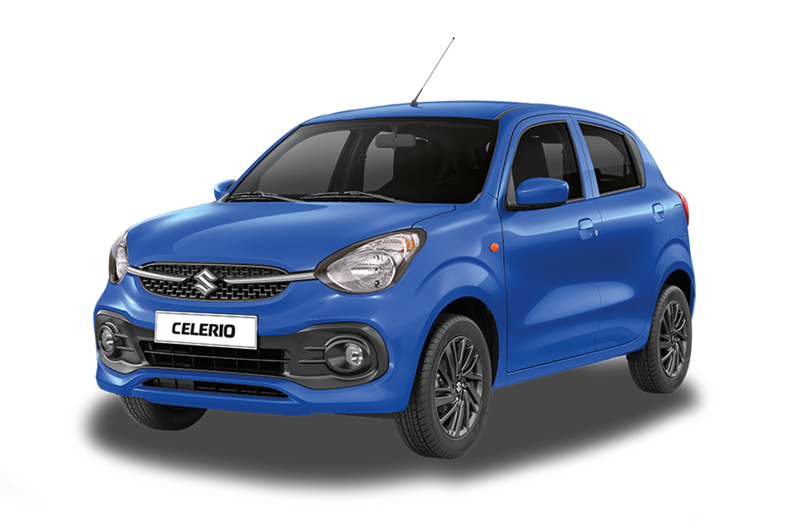
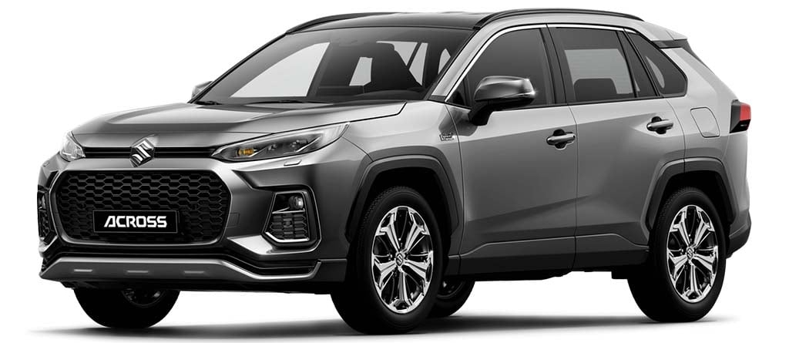

Remember Suzuki?
Suzuki Celerio
Starting Price: Approx €10,000 & 25 kpl
Suzuki Across
Starting Price: Approx
€53,000 & 17.9 kpl
there is low correlation between car price & fuel efficiency.
The more expensive car does not always mean best fuel efficiency.

Slide 14
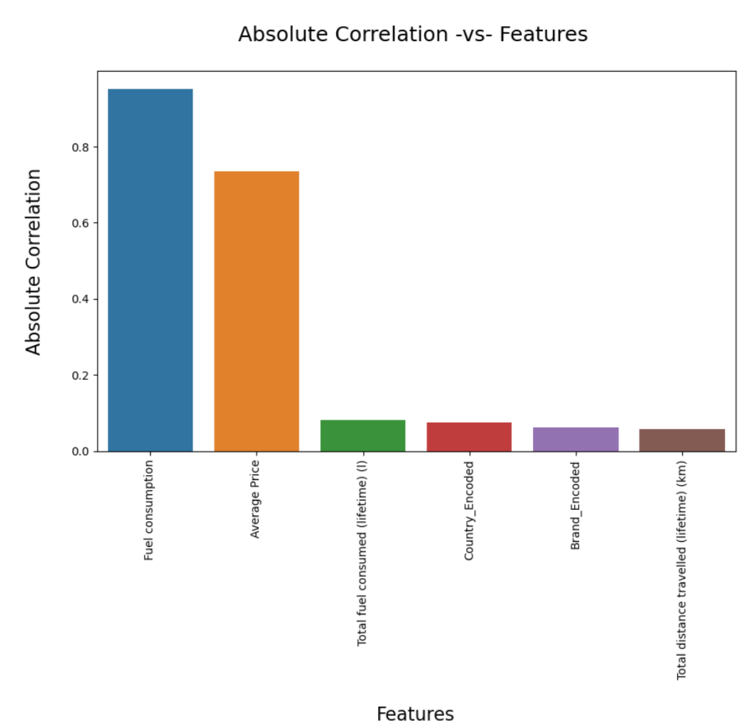
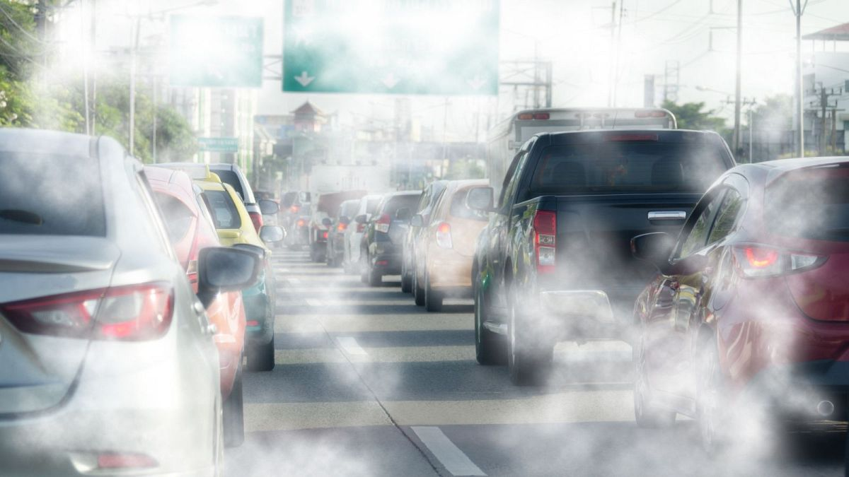
What matters is how much fuel you consume!

Slide 15
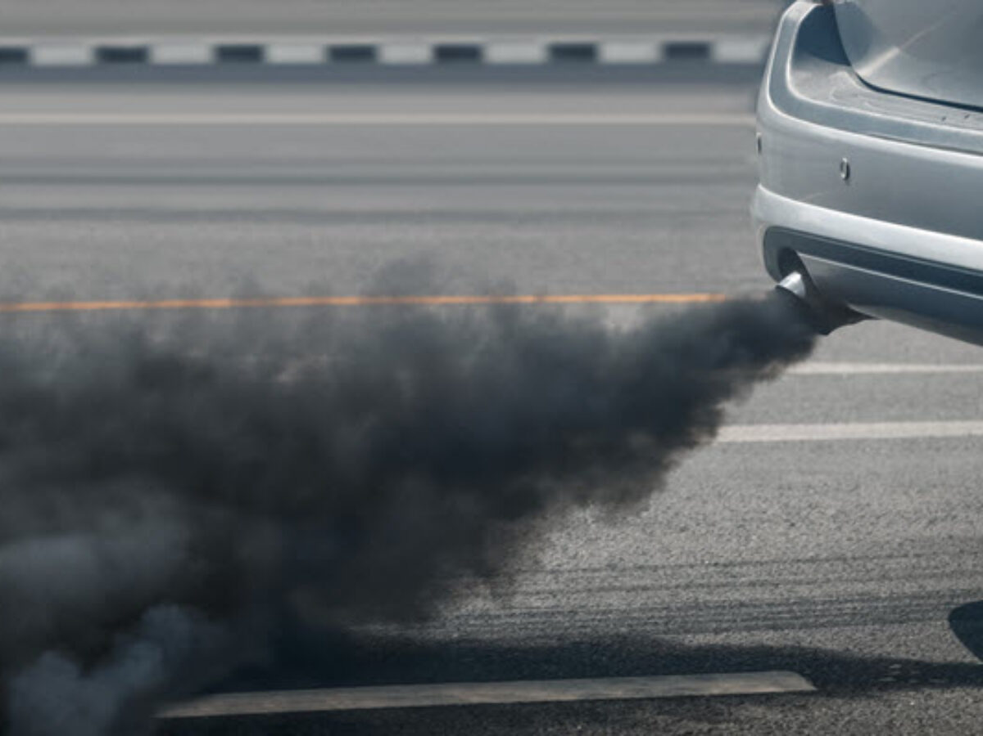
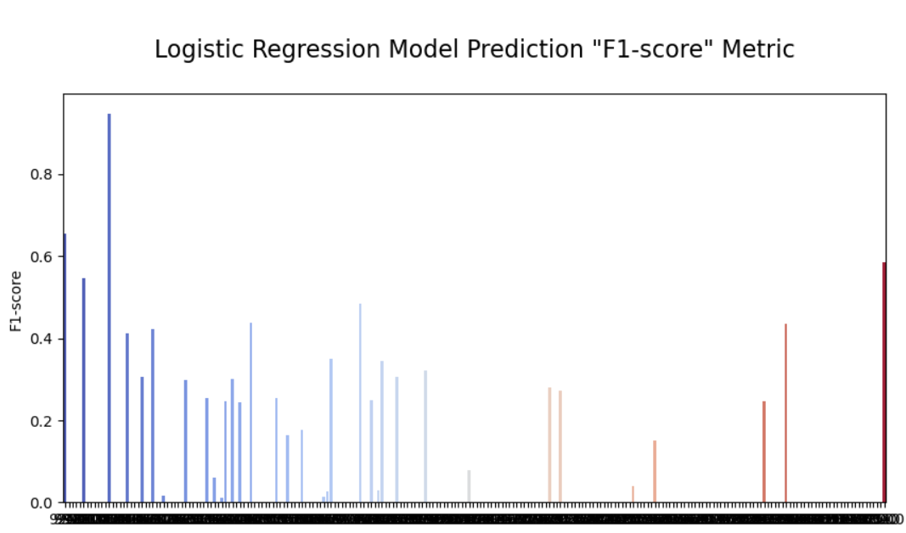
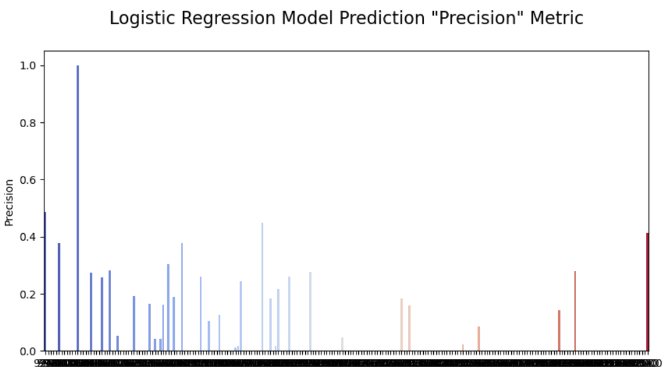
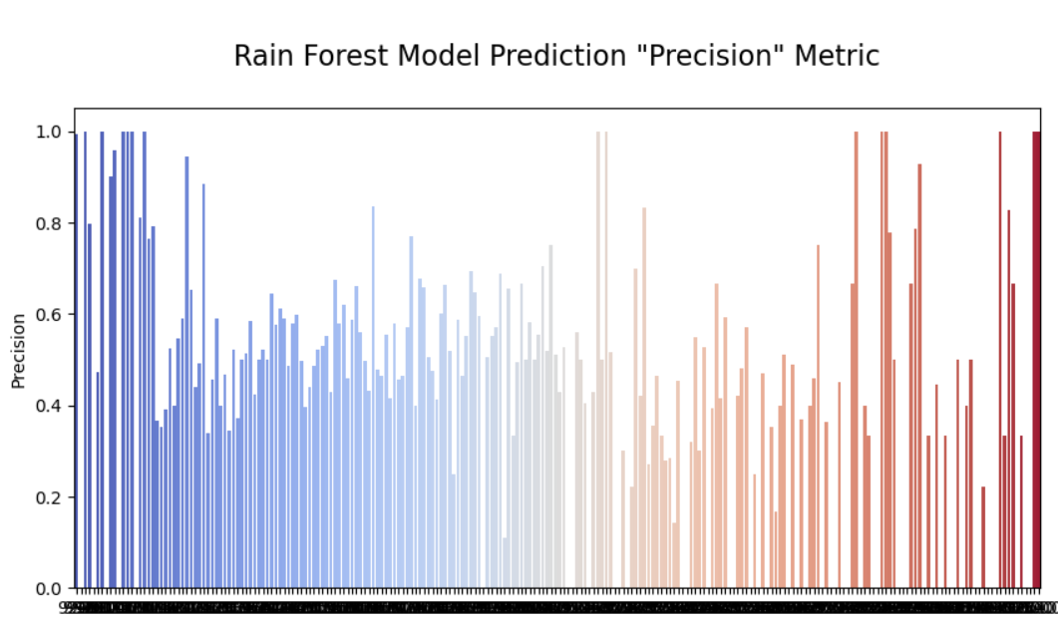
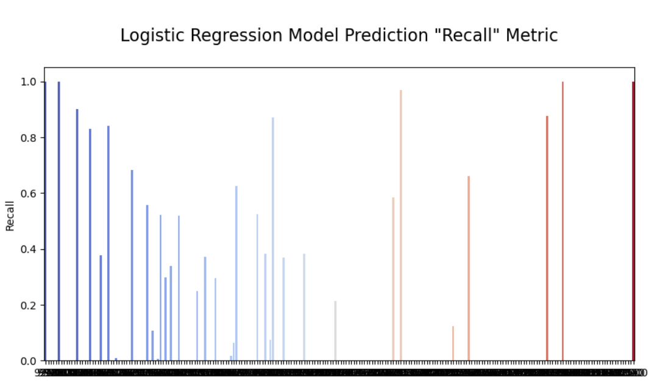
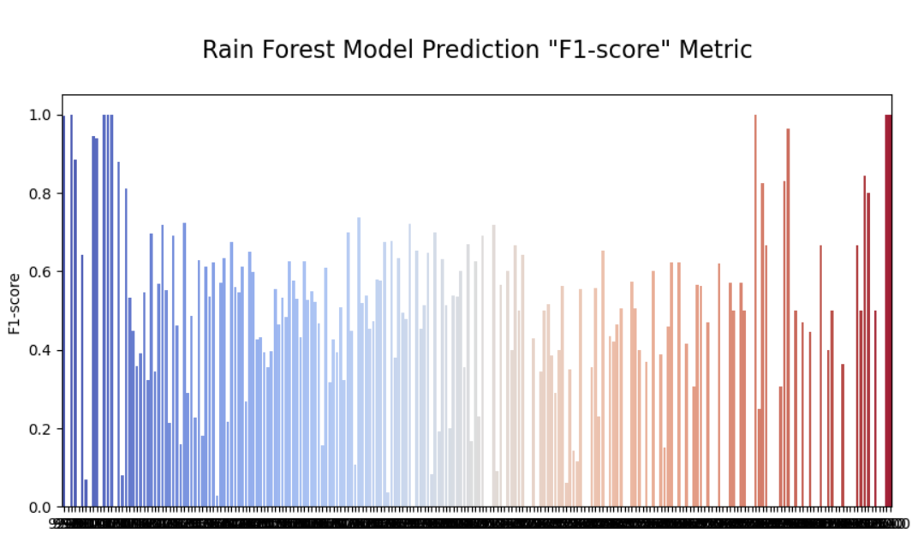

Just to be sure, we ran some tests…
… On 37 columns & 916,273 rows of data

Slide 16
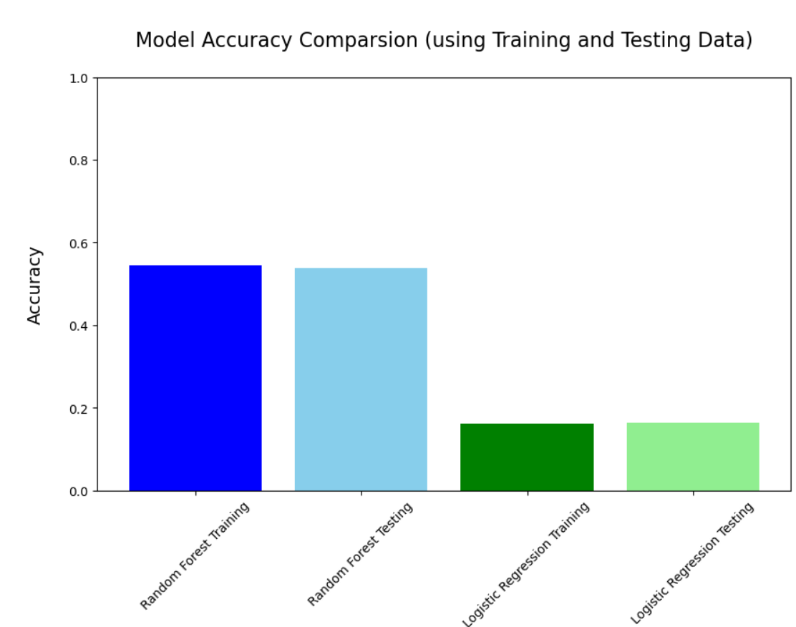
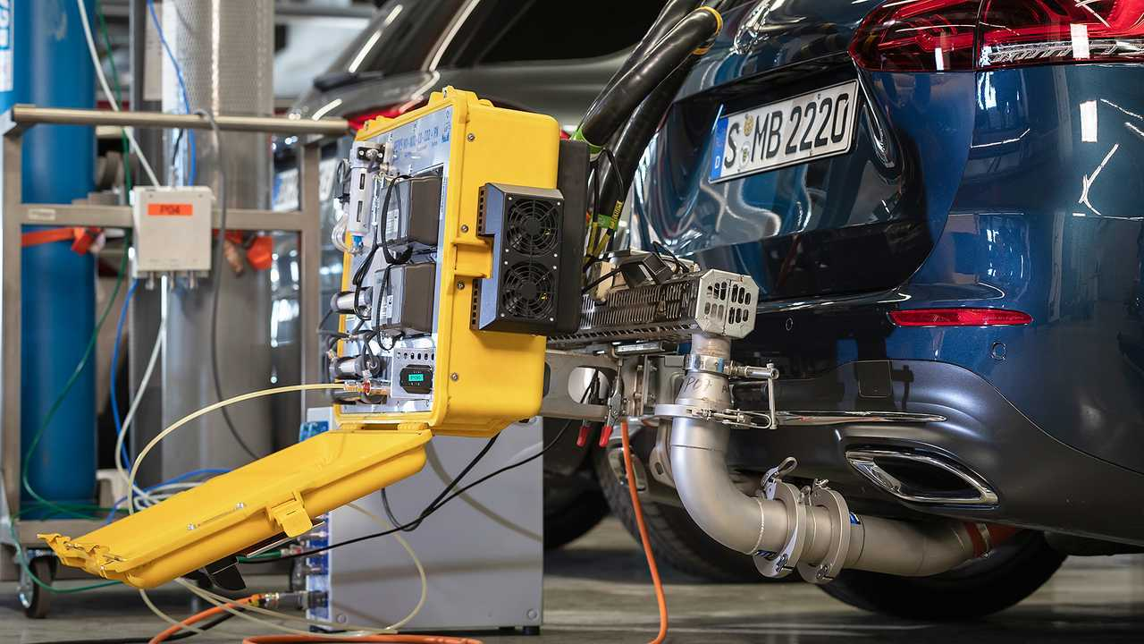
And just like Co2 tests, we tested the accuracy of our tests…

Slide 17
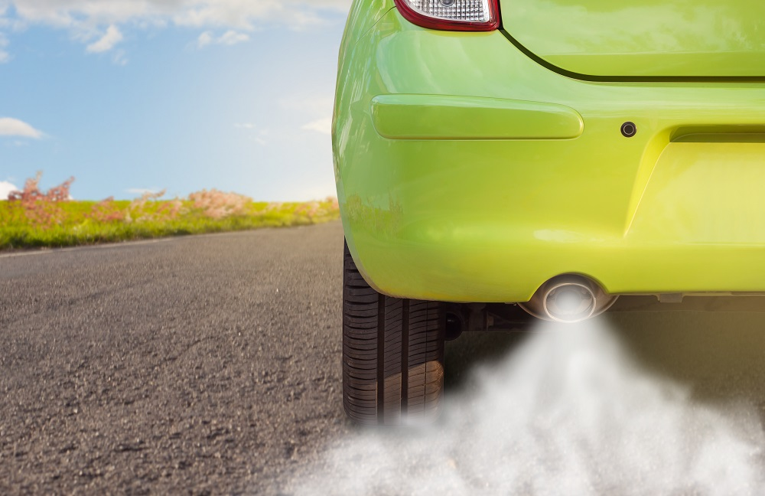
At the end of the day it doesn’t matter what brand you own, or how much it is…
what matters is how many kilometers you drive and how much fuel you consume.

